Slide 1

Q2012
Steve Lyle

Slide 2
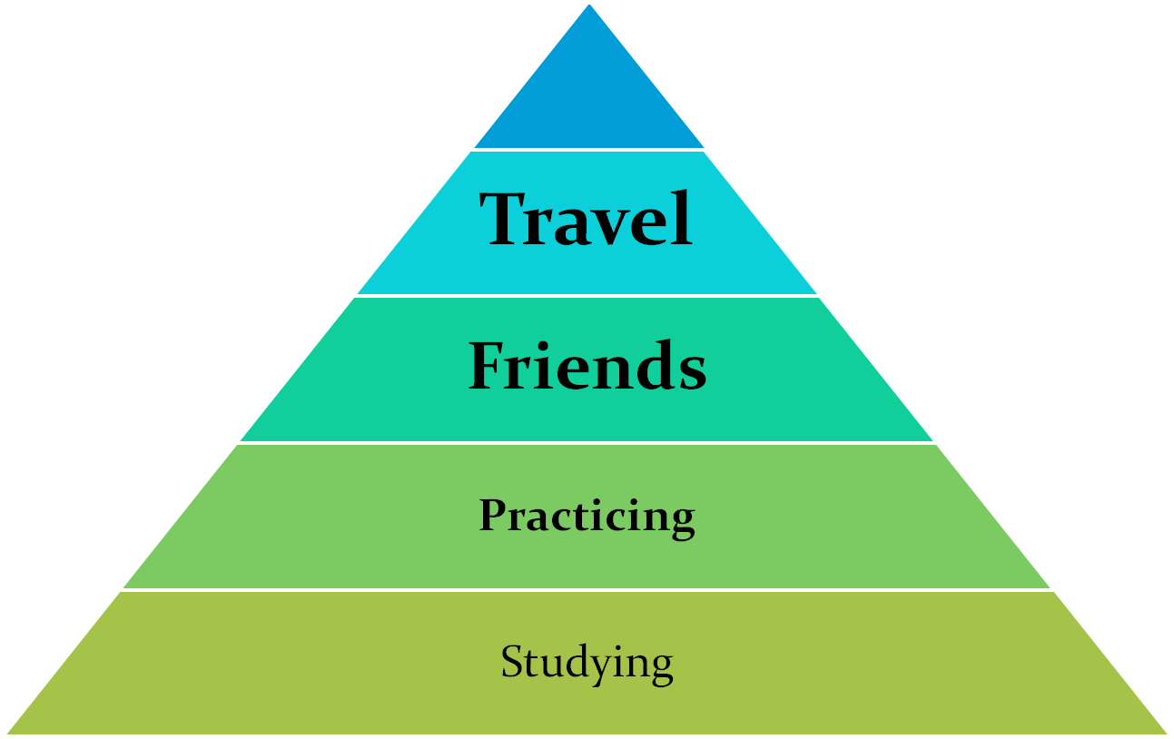
Quizzing Pyramid
Competition

Slide 3
What’s the Best Way to Study?
Individualistic
May change with time/experience
Depends on your learning style:
  Visual
  Auditory
  Kinesthetic (or tactile)
  Many sub-groups and/or combinations of these styles.

Slide 4
Visual Learners
Most folks are visual learners of one sort or another.
Most study techniques have been geared toward visual learners.
When trying to learn or recall information may help to close eyes to try and visualize it.
Helps to avoid visual distractions when studying, but may help to make illustrations as you take notes.
Using highlighters can be an important technique for learning as well as writing and reviewing notes.

Slide 5
Auditory Learners
Not as many, approximately 20% of the population.
Learn well from verbal directions, group discussions, reading aloud and putting information into a rhythmic pattern such as a rap, poem or song.
May work well to record notes and replay rather than reading.
Remember details by trying to “hear” previous discussions.
Study by reading information out loud.
Whisper new information when alone.

Slide 6
Kinesthetic Learners
Least common, approximately 5% of population.
Helps for these students to move around when studying.
Common for kinesthetic learners to focus on two different things at the same time.
Possess good eye-hand coordination.
May be perceived as “disruptive” because of their need to move.

Slide 7
Today’s Approach
Introduce a number of styles:
Brief description/examples
Encourage you to try at least several different approaches. Use what works, move on from what doesn’t work.
Try combining different styles, especially from different learning styles.

Slide 8
The Basics
Commitment – Nothing will happen until you make it a priority. No bonus points for good intentions.
Time – Again this is a function of the priority that you assign. If you want to be good at something, you have to invest your time.
Scripture – Whether you read it, listen to it, or view it all of quizzing comes back to the scripture, the better you know it, the better quizzer you will be.
Goals – Set short-term and long–term goals for yourself. Reward yourself when you reach them.

Slide 9
Basics Cont.
Begin with the end in mind – What type(s) of quizzer do you want to be this year?
  Memory – learn them all, know them well.
  According to – emphasize paraphrase memorization. Learn to associate references with subject.
  General – Need a good handle on all of the information.
  Specialty Questions – Not too many chances in a round. Better have another area covered as well.

Slide 10
Resources
Scripture Portion:
  Pocket style
  Spiral bound type
    Memory
    Key words
    Concordance
    Additional Information
  Listening CD
Questions:
  Yellow and Blue books
  Computer databases
  Old Questions, questions you write, any questions you can find!
Games
DVD
Rule book

Slide 11
Styles
Initial Learning:
  Straight through Reading – Chapter 5X
  Repetition Method – Each verse 3X (1-5), now all 5, repeat with 6-10, etc.
  Outlining – create outline as you read chapter.
  Memorizing
    For memory work – Focus on memory verses
    According to and General – Paraphrase memorizing.
  Writing Questions
  Keywords – mark and review.
  Kinesthetic – Act it out, use legos or puppets, etc.

Slide 12
Styles Cont.
Review
  Very important part of the learning process. If you don’t review you will forget.
  3-5-7 Plan: Review the chapter 3 before your current chapter, then 5 before, and then 7 before. When you get to higher chapters either add another (3-5-7-9), or change the interval (4-8-12).
  Memory – Have a card deck (or equivalent) that you can access on a random basis. Review all at regular intervals.
  Review questions – Print off questions for yourself, have a computer program ask them, or have a friend or relative ask you questions. Make sure to pre-jump.
  When reviewing questions two important resources are concordences and commentaries. Help you answer those “I thought…” and “what does that mean” questions.
  Listening CD and DVD – Review until it drives everyone else crazy.

Slide 13
Conclusions
Find styles that work for you and feel free to change them to suit you needs. Rotate or combine methods to keep it interesting and for more effect.
Find someone who will ask you questions or listen to you quote.
Find out how other quizzers study and experiment with their methods, share you methods with others.
Remember the more effective your studying, the more effective your quizzing will be. Find methods that will not only increase your knowledge but also increase your speed.

Slide 14
Conclusions Cont.
Remember there is a double, triple, quadruple benefit to studying quizzing.
  You’ll have gained additional information for the next quiz,
  You’ll have learned more about yourself and your learning methods,
  You’ll have more of God’s word hidden in your heart where it will be able to assist you throughout your life (Isaiah 55:11 “so is my word that goes out from my mouth: It will not return to me empty, but will accomplish what I desire and achieve the purpose for which I sent it.”)
  You’ll be able to assist your friends and family with the scripture that you have learned.

